Slide 1

Problem Solving Session
The remainder of today’s class will comprise the problem solving session (PSS).
Your instructor will divide you into teams of 3 or 4 students.
Each team will work together to solve the following problems over the course of 20-30 minutes.
You may work on paper, a white board, or digitally as determined by your instructor.
You will submit your solution by pushing it to GitHub before the end of class.
Your instructor will go over the solution before the end of class.
Write your name on each completed sheet.
Submit to the designated MyCourses’ Dropbox.
Class participation is a significant part of your grade (20%). This includes in class activities and the problem solving session.
Your graders will grade your participation by verifying that you pushed your solutions before the end of the class period each day.

Slide 2
Problem 1
Name: Advika | Prior Experience (0-10): 5.5
Comments: I have learned the basics of python and SQL in my high school. So during my vacation I thought I’ll put that 2 years knowledge into use so I applied for an internship but when I was given a task to perform in python, it was way out of my scope as I didn’t learn it in school. That’s when I realized I’m still in the path of learning and exploring the field of programing.
Software Development & Problem Solving is designed for students of all levels of experience. There are students in this classroom with little or no programming experience, students who have been coding for years, and every skill level in between.
Spend a few minutes talking with your team members about your prior experience with programming (in any language, not just Python).
Rate yourselves on a scale of 0 (very little or no experience) to 10 (you should be teaching this class!).
Fill out the tables with each of your answers.
Name: Amaal | Prior Experience (0-10): 7
Comments: I have learnt python in the past 2 years. I have come across many modules which can be put into great use while programing. I do feel I’m a little rusty in few areas but I’m confident that I can overcome that by the end of the semester.
Name: Ismail | Prior Experience (0-10): 5
Comments: I have had a prior experience in HTML for 2 years.
If you are working digitally and need more space, duplicate this slide.

Slide 3

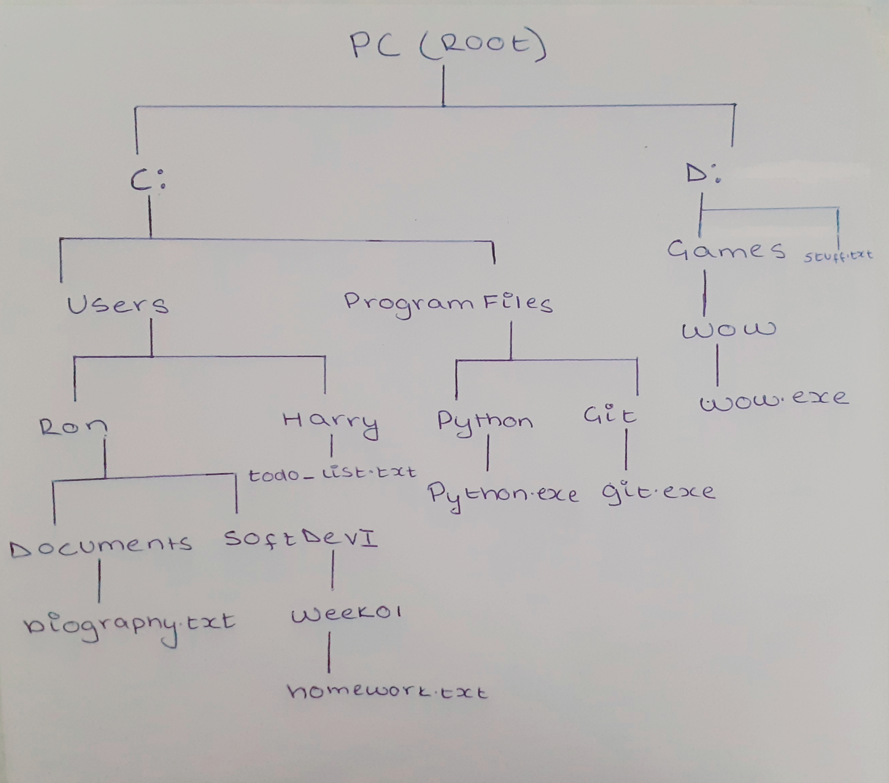
Problem 2
File
Dir
X:
Files in the file system are organized into a tree structure. Visualizing this structure can make finding files and directories more intuitive.
Assume that each of the following is an absolute path to a file in your file system. Draw the tree that represents the structure in the space on the left.
Your instructor will determine if you should work digitally, on paper, or on a whiteboard. Use the icons to the left as references.
C:\Users\Ron\Documents\biography.txt
C:\Users\Ron\SoftDevI\Week01\homework.txt
C:\Users\Harry\todo_list.txt
C:\Program Files\Python\python.exe
C:\Program Files\Git\git.exe
D:\Games\WoW\wow.exe
D:\stuff.txt

Slide 4
Problem 3
1. Created a new file (Working copy )(status-Untracked)
2. Added the file to staging area (status-Staged (changes to be committed))
3.Commited the file to Local repository (Status- Nothing to commit )
4. Saved the file to remote repository that’s the main server (Status- Nothing to commit)
5.Staging area (changes not staged for commit)
Understanding the status of the files in your repository is important! Have you made changes to any files that need to be committed? What has been added, modified, deleted, or staged since your last commit?
Consider the following commands executed in a Git repository on your computer. Together with your team, describe the status of the file at each step.
notepad new_file.txt
git add new_file.txt
git commit -m "adding a new file"
git push
notepad new_file.txt (add text)

Slide 5
Problem 4
It’s a good idea to check the status before staging so that we can get an overview and confirm the current status of the file and see if it changes after staging. The status also provides helpful guidelines, as to what action you may want to perform next on each file.
2. When starting a brand new assignment we need to create a remote repository on github and then clone it to your local computer (using url) to store your project in it.
3. The last thing you should do is to push your work in to git hub so that is permanently saved. In case of disaster data is not lost as it’s safe on github. When you want to rework on it you can always pull back from github.
4. When using a different computer we need to clone the repository from the VCS(Git hub) using ‘git clone <url>’ so that we can create a local copy of the repository on our laptop and work on it.
Proper use of version control means understanding why we use it and not just memorizing how to use it.
Discuss the following questions with your team, and type or write your answers in the space on the right.
Why do you think that it is a good idea to check the status before staging files?
When starting a brand new assignment, what is the first thing you should do, and why?
What is the last thing that you should do before taking a break from working?
Assume that you are getting back to work on a different computer. What is the first thing you should do?

